Slide 1
CHAPTER 2 HADOOP HDFS & MAPREDUCE

Slide 2
Contents
2.1 Distributed File Systems : Physical Organization of
Compute Nodes, Large-Scale File-System Organization.
2.2 MapReduce: The Map Tasks, Grouping by Key, The
Reduce Tasks, Combiners, Details of MapReduce
Execution, Coping With Node Failures.
2.3 Algorithms Using MapReduce:
Matrix-Vector Multiplication by MapReduce ,
Relational-Algebra Operations,
Computing Selections by MapReduce,
Computing Projections by MapReduce,
Union, Intersection, and Difference by MapReduce, Computing Natural Join by MapReduce,
Grouping and Aggregation by MapReduce,
Matrix Multiplication,
Matrix Multiplication with One MapReduce Step.
2.4 Hadoop Limitations

Slide 3
Single Node Architecture
CPU
Machine Learning, Statistics
Memory
“Classical” Data Mining
Disk

Slide 4
Cluster Architecture
Switch
Switch
Switch
CPU
CPU
CPU
CPU
Mem
…
Mem
Mem
…
Mem
Disk
Disk
Disk
Disk
Each rack contains 1000 nodes

Slide 5


Slide 6
Cluster computing challenges(1)
Node failures
A single server can stay up for 3 years ( 1000 days)
1000 servers in cluster => 1 failure/day
1M servers in cluster => 1000 failures/day
How to store data persistently and keep it available if nodes can fail?
How to deal with node failures during a long-running computation?

Slide 7
Cluster computing challenges(2)
Network bottleneck
Network bandwidth = 1Gbps
Moving 10TB takes approximately 1 day
Distributed programming is hard !
Need a simple model that hides most of the complexity

Slide 8
MapReduce
Map-Reduce addresses the challenges of cluster computing.
Store data redundantly on multiple nodes for persistence and availability.
Move computation close to data to minimize data movement
Simple programming model to hide the complexity of all this magic

Slide 9
Distributed File System
Reliable distributed file system
Data kept in “chunks” spread across machines
Each chunk replicated on different machines
Seamless recovery from disk or machine failure
C₀
C₁
D₀
C₁
C₂
C₅
C₀
C₅
…
C₅
C₂
C₅
C₃
D₀
D₁
D₀
C₂
Chunk server 1
Chunk server 2
Chunk server 3
Chunk server N
Bring computation directly to the data!
Chunk servers also serve as compute servers
Notes:
‹#›

Slide 10
Distributed File System
Chunk servers
File is split into contiguous chunks
Typically each chunk is 64MB/128 MB
Each chunk replicated (usually 2x or 3x)
Try to keep replicas in different racks
Master node
Name Node in Hadoop’s HDFS
Stores metadata about where files are stored

Slide 11
Programming Model: MapReduce
Warm-up task:
We have a huge text document
Count the number of times each distinct word appears in the file
Sample application:
Analyze web server logs to find popular URLs

Slide 12
Task: Word Count
Case 1:
File too large for memory, but all <word, count> pairs fit in memory
Case 2:
Count occurrences of words:
Case 2 captures the essence of MapReduce

Slide 13
What is MapReduce??
Map Reduce is a processing technique and a program model for distributed computing based on java.
The Map Reduce algorithm contains two important tasks, namely Map and Reduce.
Map takes a set of data and converts it into another set of data, where individual elements are broken down into tuples (key/value pairs).

Slide 14
What is MapReduce??
Secondly, reduce task, which takes the output from a map as an input and combines those data tuples into a smaller set of tuples.
As the sequence of the name Map Reduce implies, the reduce task is always performed after the map job.

Slide 15
Advantages of MapReduce??
It is easy to scale data processing over multiple computing nodes.
Under the MapReduce model, the data processing primitives are called mappers and reducers.
This simple scalability is what has attracted many programmers to use the MapReduce model.

Slide 16
In brief, a MapReduce computation executes as follows:
Some number of Map tasks each are given one or more chunks from a distributed file system. These Map tasks turn the chunk into a sequence of key-value pairs. The way key-value pairs are produced from the input data is determined by the code written by the user for the Map function.
The key-value pairs from each Map task are collected by a master controller and sorted by key. The keys are divided among all the Reduce tasks, so all key-value pairs with the same key wind up at the same Reduce task.
The Reduce tasks work on one key at a time, and combine all the values
associated with that key in some way. The manner of combination of values is
determined by the code written by the user for the Reduce function.

Slide 17
MapReduce: The Map Step
Input
key-value pairs
Intermediate
key-value pairs
k
v
map
k
v
k
v
map
k
v
k
v
…
…
k
v
k
v

Slide 18
MapReduce: The Reduce Step
Output
key-value pairs
Intermediate
key-value pairs
Key-value groups
reduce
k
v
k
v
v
v
k
v
Group
by key
reduce
k
v
k
v
v
k
v
k
v
…
…
…
k
v
k
v
k
v

Slide 19
More Specifically
Input: a set of key-value pairs
Programmer specifies two methods:
Map(k, v) → <k’, v’>*
Takes a key-value pair and outputs a set of key-value pairs
E.g., key is the filename, value is a single line in the file
There is one Map call for every (k,v) pair
Reduce(k’, <v’>*) → <k’, v’’>*
All values v’ with same key k’ are reduced together and processed in v’ order
There is one Reduce function call per unique key k’

Slide 20
MapReduce: Word Counting
Provided by the programmer
Provided by the programmer
MAP:
Read input and produces a set of key-value pairs
Group by key:
Collect all pairs with same key
Reduce:
Collect all values belonging to the key and output
The crew of the space shuttle Endeavor recently returned to Earth as ambassadors, harbingers of a new era of space exploration. Scientists at NASA are saying that the recent assembly of the Dextre bot is the first step in a long-term space-based man/mache partnership. '"The work we're doing now -- the robotics we're doing -- is what we're going to need ……………………..
(The, 1)
(crew, 1)
(of, 1)
(the, 1)
(space, 1)
(shuttle, 1)
(Endeavor, 1)
(recently, 1)
….
(crew, 1)
(crew, 1)
(space, 1)
(the, 1)
(the, 1)
(the, 1)
(shuttle, 1)
(recently, 1)
…
(crew, 2)
(space, 1)
(the, 3)
(shuttle, 1)
(recently, 1)
…
Big document
(key, value)
(key, value)
(key, value)

Slide 21
Word Count Using MapReduce
map(key, value):
// key: document name; value: text of the document
for each word w in value:
emit(w, 1)
reduce(key, values):
// key: a word; value: an iterator over counts
result = 0
for each count v in values:
result += v
emit(key, result)

Slide 22
Example
The doctor ate an apple and an engineer ate banana and an apple.

Slide 23
Mapping Phase
The ,1
Doctor ,1
Ate ,1
An ,1
Apple ,1
and ,1
An,1
Engineer ,1
Ate ,1
Banana ,1
And ,1
An ,1
Apple ,1

Slide 24
Shuffle and Sort Phase
An [1,1,1 ]
Apple [1,1]
Ate [1 ,1]
And [1,1]
Banana [1]
Doctor [1 ]
Engineer [1]
The [1]

Slide 25
Reduce Phase
An [3 ]
Apple [2]
Ate [2]
And [2]
Banana [1]
Doctor [1 ]
Engineer [1]
The [1]

Slide 26
Map-Reduce: Environment
Map-Reduce environment takes care of:
Partitioning the input data
Scheduling the program’s execution across a set of machines
Performing the group by key step
Handling machine failures
Managing required inter-machine communication

Slide 27
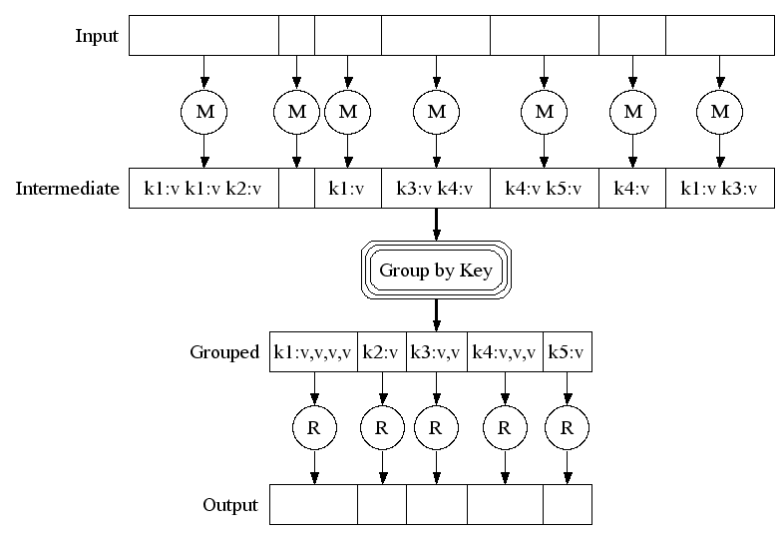
Map-Reduce: A diagram
Big document
MAP:
Read input and produces a set of key-value pairs
Group by key:
Collect all pairs with same key
(Hash merge, Shuffle, Sort, Partition)
Reduce:
Collect all values belonging to the key and output

Slide 28
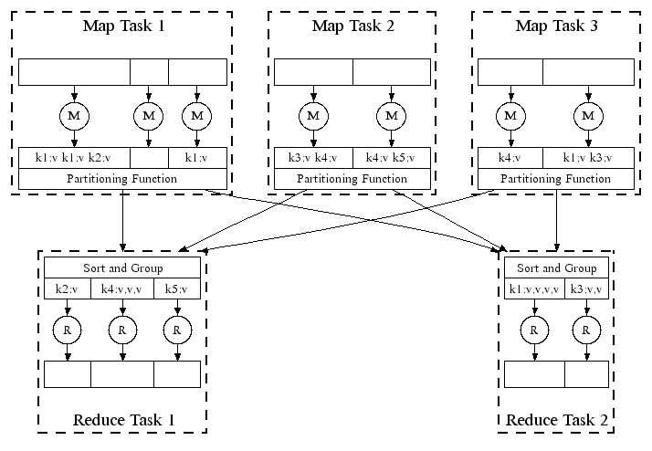
Map-Reduce: In Parallel
All phases are distributed with many tasks doing the work

Slide 29
Data Flow
Input and final output are stored on a distributed file system (FS):
Scheduler tries to schedule map tasks “close” to physical storage location of input data
Intermediate results are stored on local FS of Map and Reduce workers

Slide 30
Coordination: Master
Master node takes care of coordination:
Task status: (idle, in-progress, completed)
Idle tasks get scheduled as workers become available
When a map task completes, it sends the master the location and sizes of its R intermediate files, one for each reducer
Master pushes this info to reducers
Master pings workers periodically to detect failures

Slide 31
How many Map and Reduce jobs?
M map tasks, R reduce tasks
Rule of a thumb:
Make M much larger than the number of nodes in the cluster
One DFS chunk per map is common
Improves dynamic load balancing and speeds up recovery from worker failures
Usually R is smaller than M
Because output is spread across R files

Slide 32
WORD COUNT PROGRAM
This consists of three portions
•The driver Code –Code that runs on the client to configure and submit the job
•The Mapper
•The Reducer

Slide 33
Mapper Code
import java.io.IOException;
import org.apache.hadoop.io.IntWritable;
import org.apache.hadoop.io.LongWritable;
import org.apache.hadoop.io.Text;
import org.apache.hadoop.mapreduce.Mapper;
public class MyMapper extends Mapper<LongWritable, Text, Text, IntWritable>
{
@Override
public void map(LongWritable key, Text value, Context context) throws IOException, InterruptedException)
{
private final static IntWritable one = new IntWritable(1);
private Text word = new Text();
String line = value.toString();
StringTokenizer tokenizer = new StringTokenizer(line);
while (tokenizer.hasMoreTokens())
{
word.set(tokenizer.nextToken());
context.write(word, one);
}
}

Slide 34
Reducer code
public class MyReducer extends Reducer<Text, IntWritable, Text, IntWritable>
{
@Override
protected void reduce(Text word, Iterable<IntWritable> it, Context context) throws IOException, InterruptedException
{
System.out.println("Word= "+word.toString()); int
int count=0;
for(IntWritable i:it)
{
count=count+i.get();
}
context.write(word,new IntWritable(count));
}
}

Slide 35
Driver Code
import org.apache.hadoop.fs.Path;
import org.apache.hadoop.io.IntWritable;
import org.apache.hadoop.io.Text;
import org.apache.hadoop.mapreduce.lib.input.FileInputFormat;
import org.apache.hadoop.mapreduce.lib.output.FileOutputFormat;
import org.apache.hadoop.mapreduce.Job;
public class WordCount
{
public static void main(String[] args) throws Exception
{
if (args.length!= 2)
{
System.out.printf("Usage: WordCount<input dir> <output dir>\n");
System.exit(-1);
}
}
}

Slide 36
Driver code ( cont.)
Job job= new Job();
job.setJarByClass(WordCount.class);
job.setJobName("Word Count");
FileInputFormat.setInputPaths(job, new Path(args[0]));
FileOutputFormat.setOutputPath(job, new Path(args[1]));
job.setMapperClass(MyMapper.class);
job.setReducerClass(MyReducer.class);
job.setMapOutputKeyClass(Text.class);
job.setMapOutputValueClass(IntWritable.class);
job.setOutputKeyClass(Text.class);
job.setOutputValueClass(IntWritable.class);
Boolean success = job.waitForCompletion(true);
System.out.println(success);
//System.exit(success ? 0 : 1);
} }

Slide 37
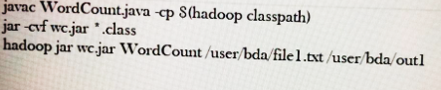

Slide 38
RELATIONAL-ALGEBRA OPERATIONS

Slide 39
Outline
Algorithm Using MapReduce
Relational-Algebra Operations
Relational-Algebra by MapReduce
Matrix-Vector Multiplication
Matrix-Vector Multiplication by MapReduce
Matrix Multiplication
Matrix Multiplication with one MapReduce

Slide 40
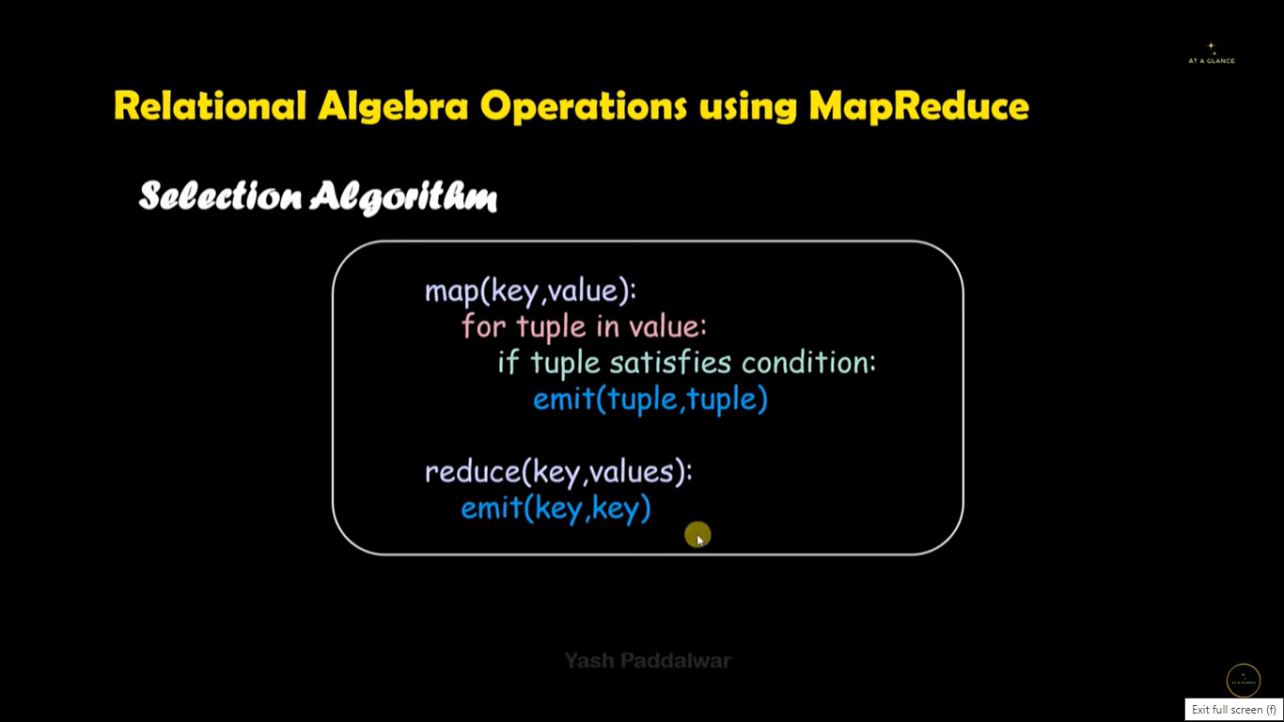

Slide 41
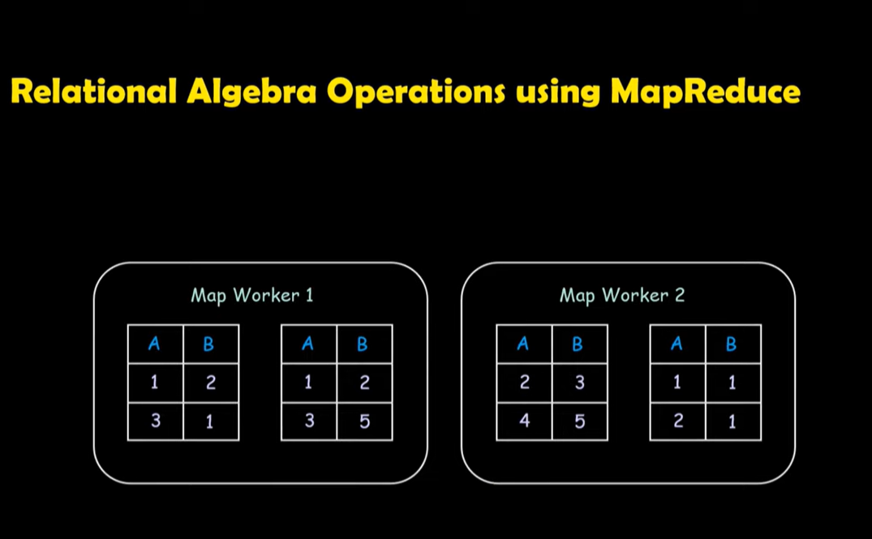

Slide 42
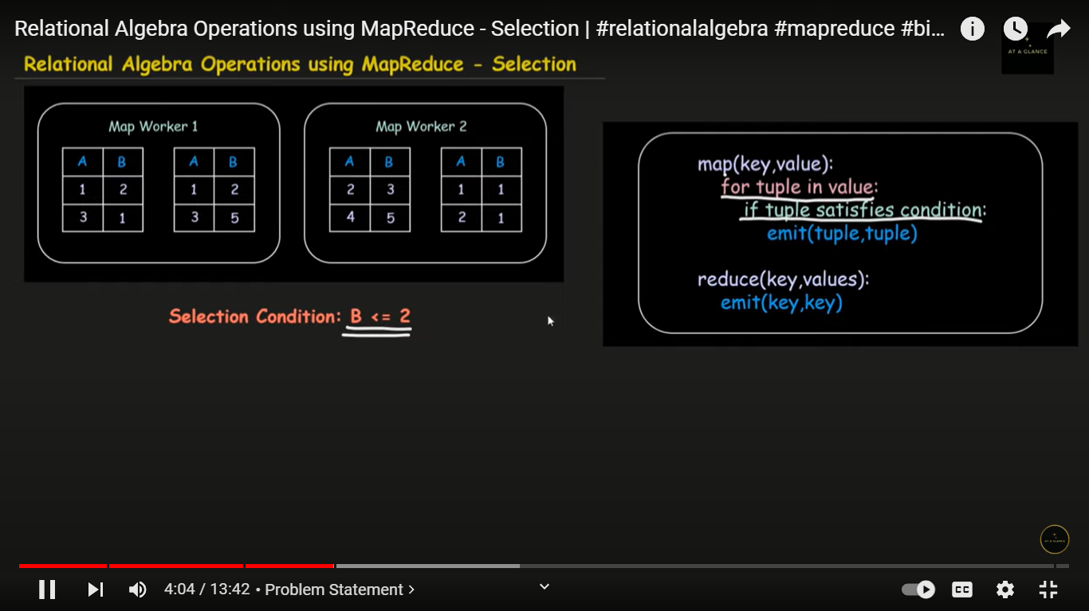

Slide 43
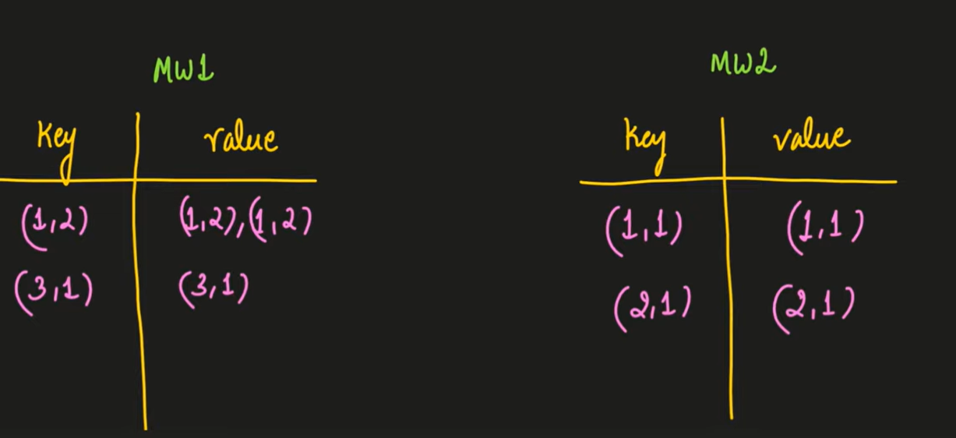

Slide 44
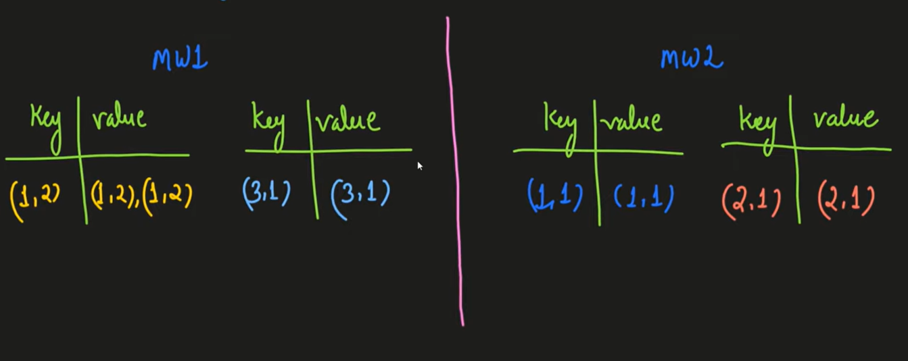

Slide 45
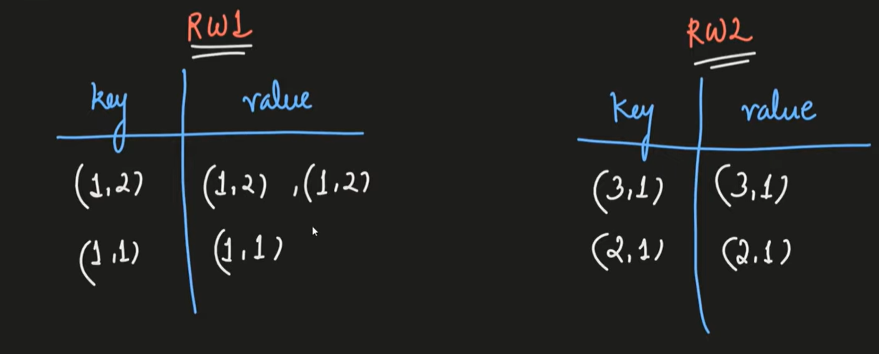

Slide 46
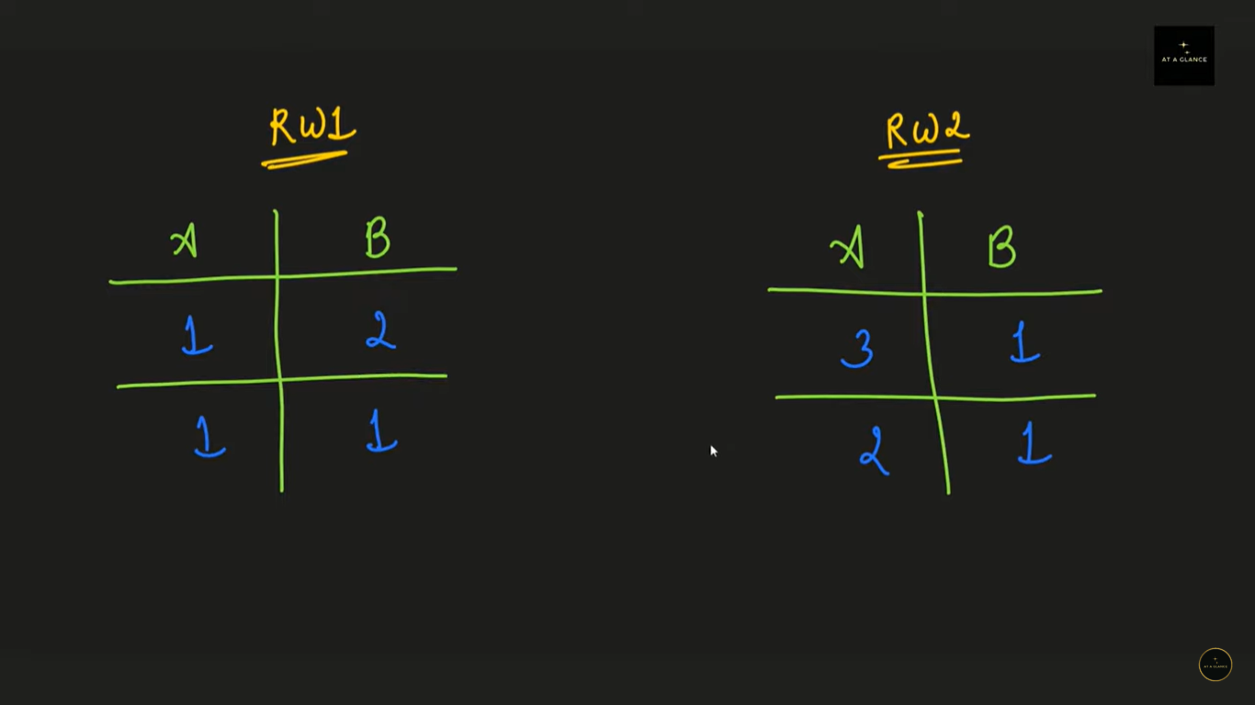

Slide 47
Selection using MapReduce
Apply a condition C to each tuple in the relation and produce as output only those tuples that satisfy C. The result of this selection is denoted sigma σ_{C}(R).
Student
sID | Name | Grade | Class
S01 | Adem | 5 | C
S02 | Bob | 4 | A
S03 | Cathy | 6 | B
S04 | Dave | 5 | B
Result = Delta δ_{Grade >5} (Students)
sID | Name | Grade | Class
S03 | Cathy | 6 | B

Slide 48
Selection using MapReduce
Map:
For each tuple t in R, test if it satisfies C.
If so, produce the key-value pair (t, t).
That is, both the key and value are t.
Reduce:
It simply passes each key-value pair to the output.

Slide 49
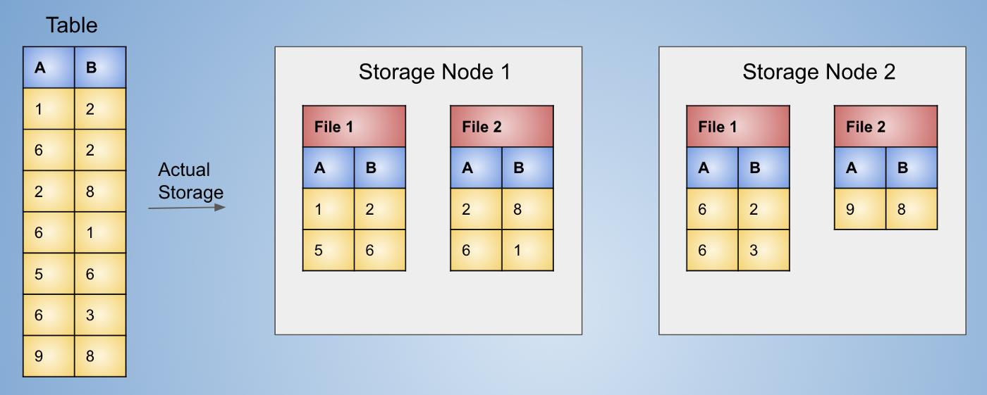
Storage of Database Table on Hadoop

Slide 50
Selection using MapReduce
Selection(B <= 3). Select all the rows where value of B is less than or equal to 3.

Slide 51
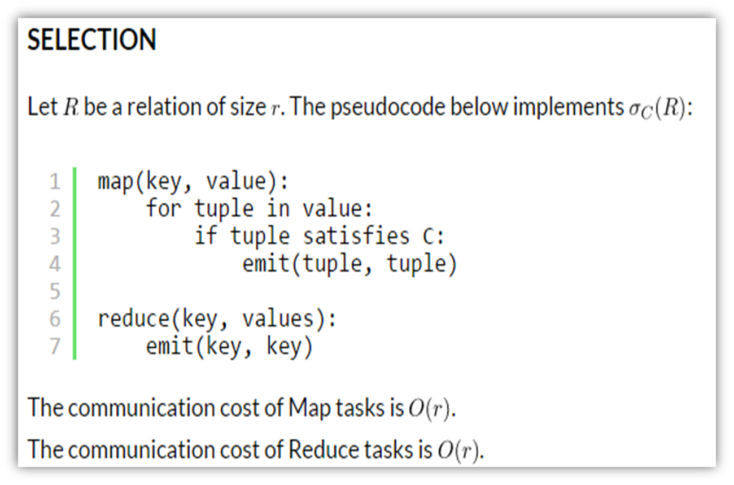

Slide 52
Projections by MapReduce
For some subset S of the attributes of the relation, produce from each tuple only the components for the attributes in S. The result of this projection is denoted π_{S}(R).
Result = π_{sID, Name} (Students)
sID | Name
S01 | Adem
S02 | Bob
S03 | Cathy
S04 | Dave

Slide 53
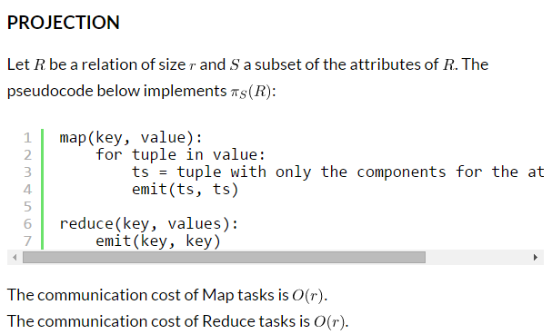
Projections by MapReduce
Map over tuples, emit new tuples with appropriate attributes.
The Reduce function is for duplicate elimination

Slide 54
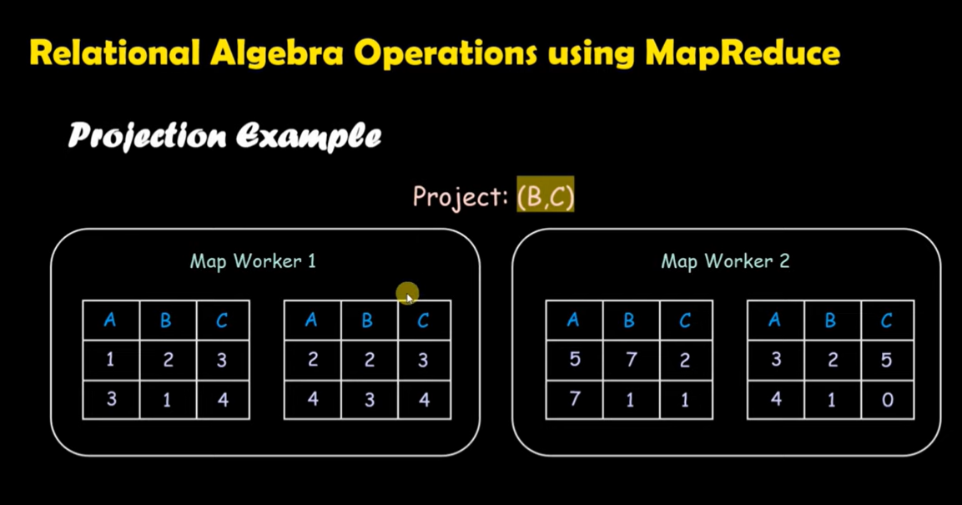

Slide 55
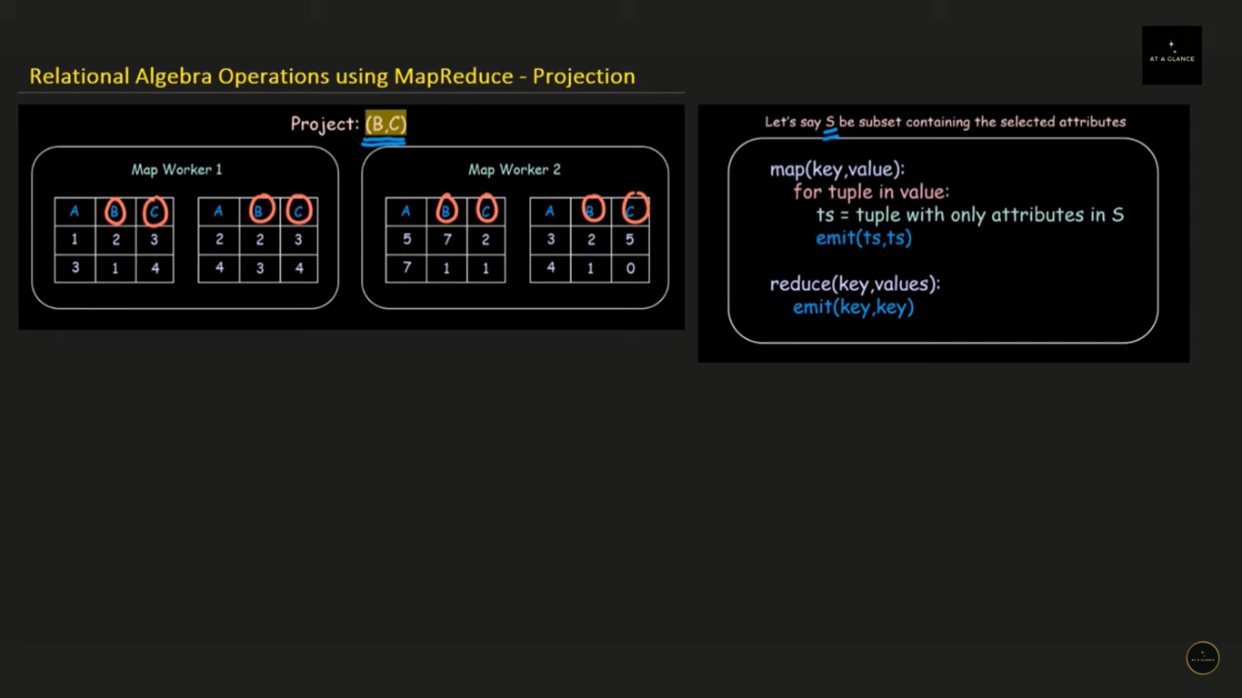

Slide 56
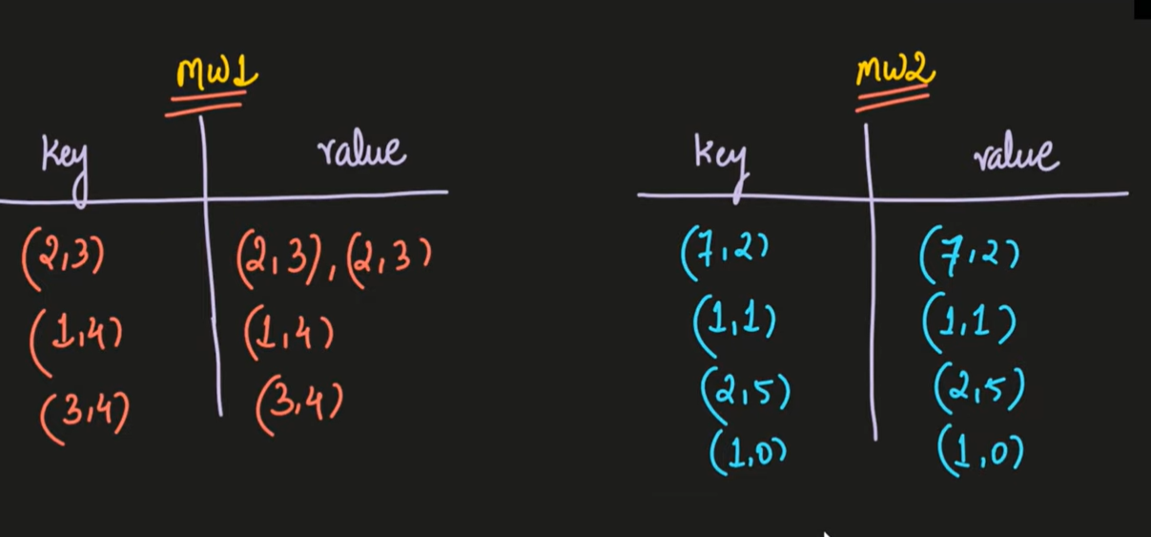

Slide 57
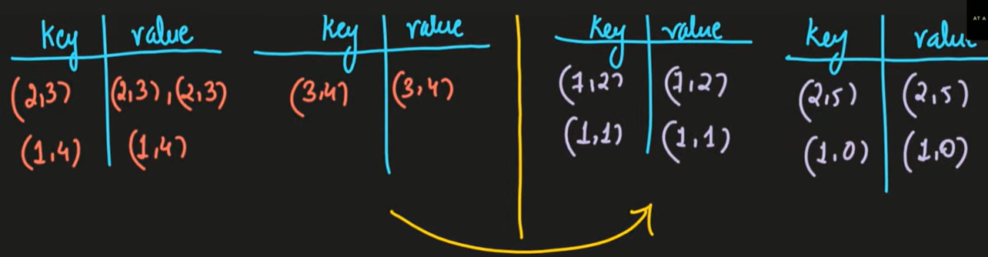

Slide 58
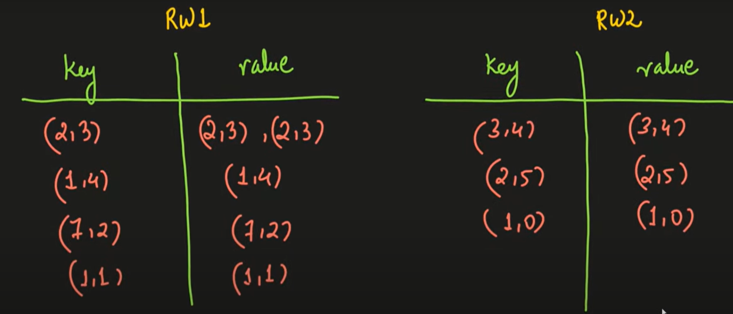

Slide 59
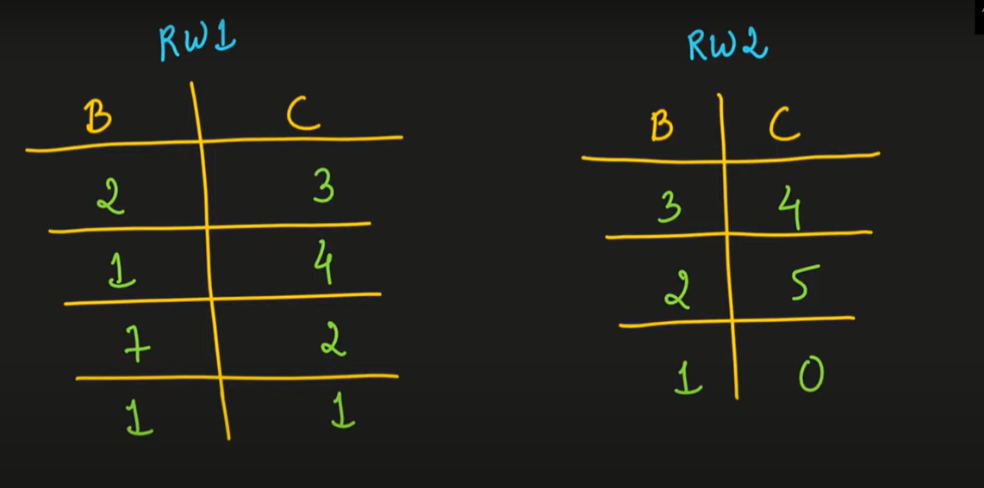

Slide 60
Projections by MapReduce
Map:
For each tuple t in R, construct a tuple t′ by eliminating from t those components whose attributes are not in S.
Output the key-value pair (t′, t′).
Reduce:
For each key t′ produced by any of the Map tasks, there will be one or more key-value pairs (t′, t′). The Reduce function turns (t′, [t′, t′, . . . , t′]) into (t′, t′), so it produces exactly one pair (t′, t′) for this key t′.

Slide 61
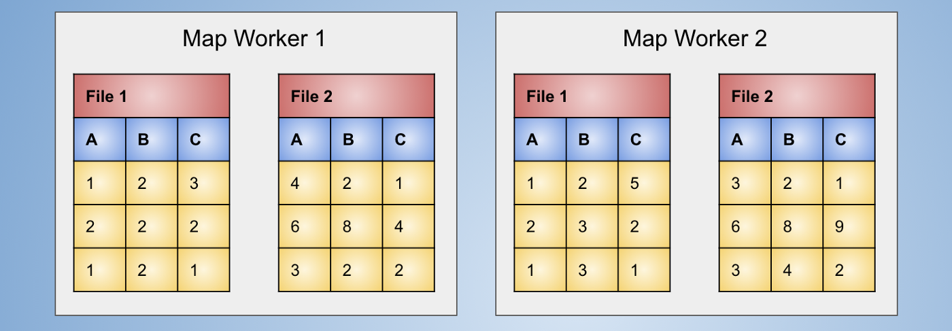
Projections by MapReduce
Let’s see it in action, by computing projection(A, B) for the following table:

Slide 62
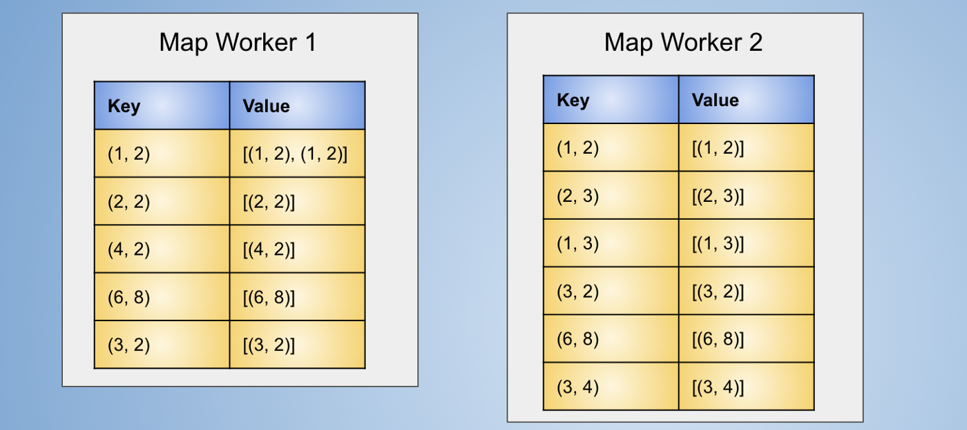
Projections by MapReduce
After application of map function (ignoring values in C column) and grouping the keys the data will look like:

Slide 63
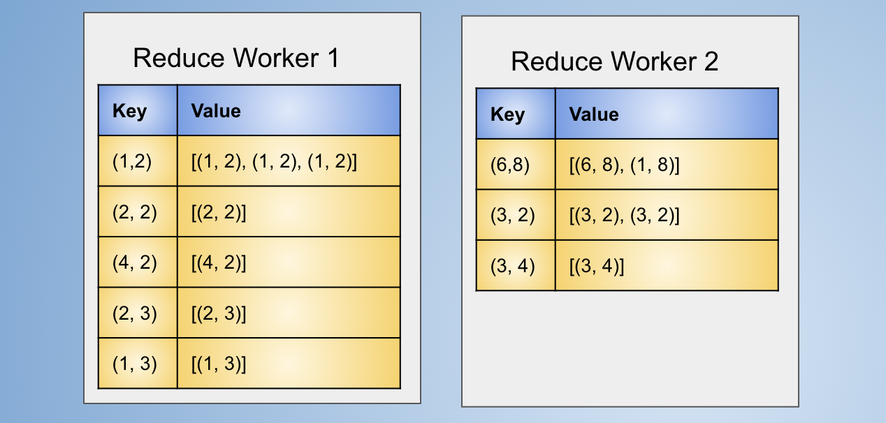
Projections by MapReduce
At the reduce node the keys will be aggregated again as same keys might have occurred at multiple map workers.
The reduce function operates on values of each key only once.
Data after aggregation by key at reduce workers

Slide 64
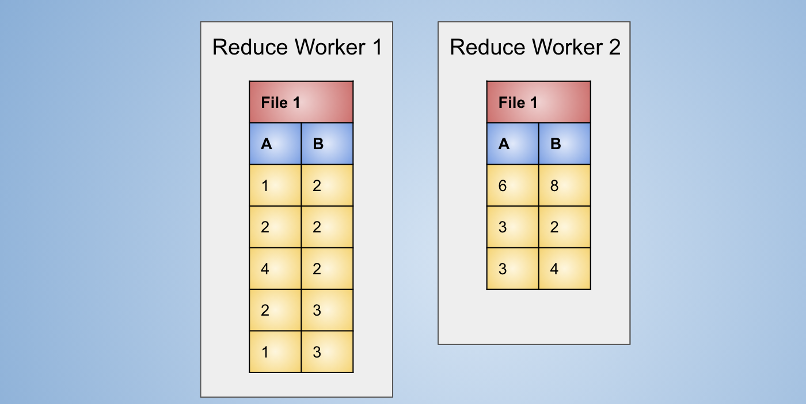
Projections by MapReduce
The reduce function is applied which will consider only the first value of the values list and ignore rest of the information.

Slide 65
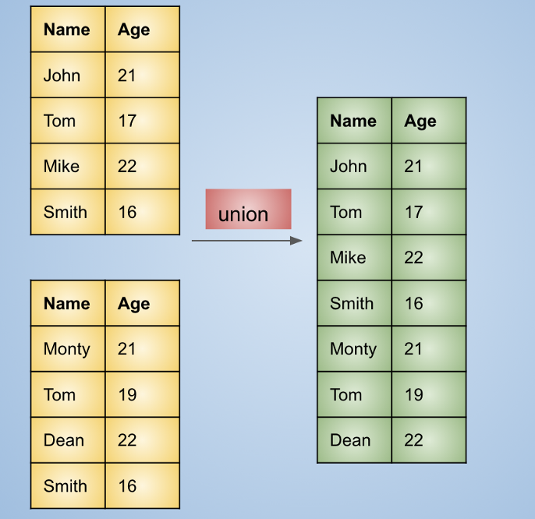
Union
Concatenate two tables vertically.
The duplicate rows are removed implicitly.
(Smith, 16) was a duplicate row so it appears only once in the output where as (Tom, 17) , (Tom, 19) appears as two, as those are not identical rows.

Slide 66
Union by MapReduce
Map:
Turn each input tuple t into a key-value pair (t, t).
Reduce:
Associated with each key t there will be either one or two values. Produce output (t, t) in either case.

Slide 67
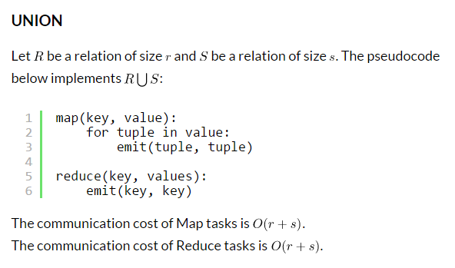
We concatenate two tables vertically. Similar to UNION in SQL, but the duplicate rows are removed implicitly. The point to note in the below output table is that (Smith, 16)was a duplicate row so it appears only once in the output where as (Tom, 17) , (Tom, 19) appears as two, as those are not identical rows.

Slide 68
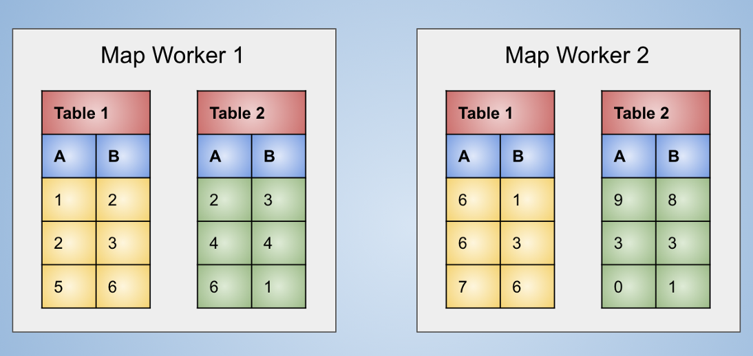
Union by MapReduce
This operations has the map function of the selection and reduce function of projection.
Initial data at map workers

Slide 69
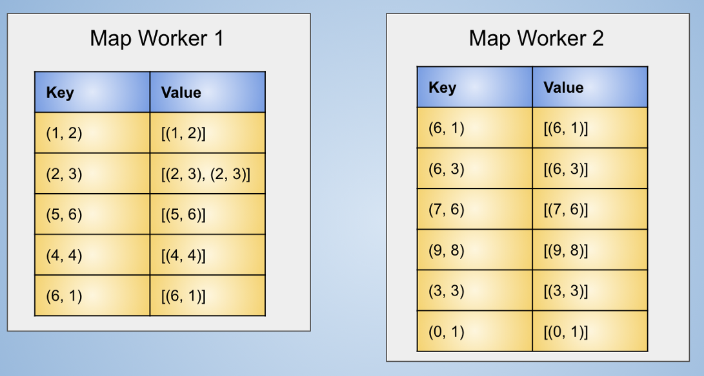
Union by MapReduce
After applying the map function and grouping the keys we will get output as:

Slide 70
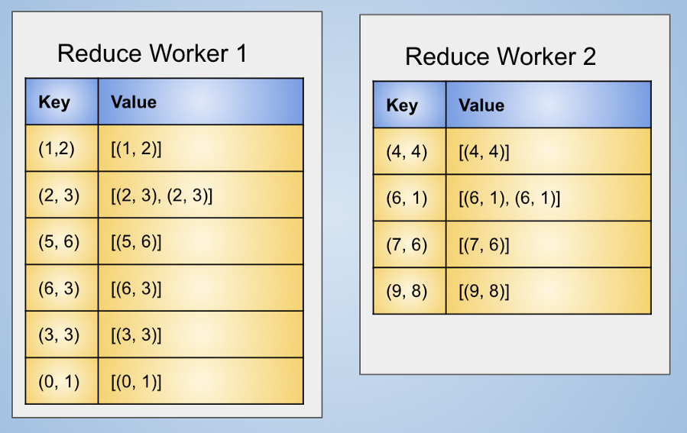
Union by MapReduce
At reduce workers aggregation on keys will be done.

Slide 71
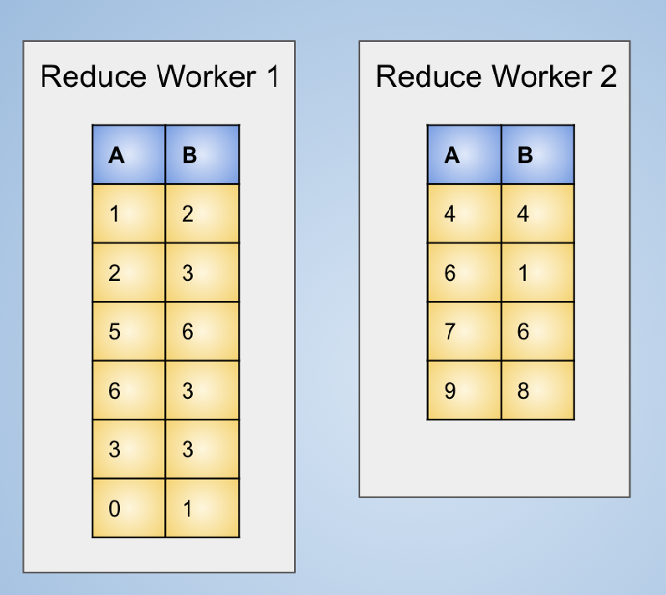
Union by MapReduce
The final output after applying the reduce function which takes only the first value and ignores everything else is as follows:

Slide 72
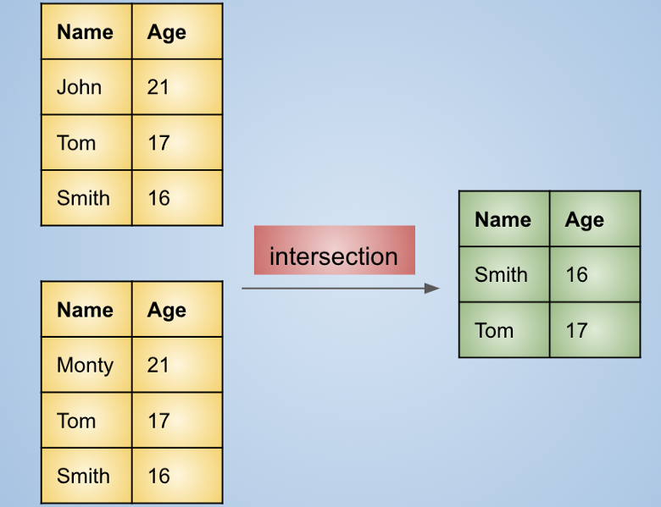
Intersection
It intersects two tables and selects only the common rows.

Slide 73
Intersection by MapReduce
Map:
Turn each tuple t into a key-value pair (t, t).
Reduce:
If key t has value list [t, t], then produce (t, t). Otherwise, produce nothing.

Slide 74
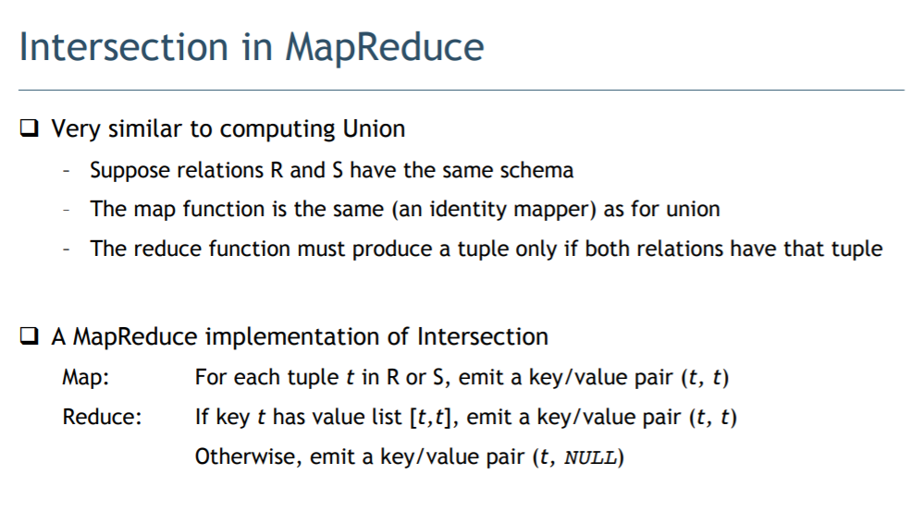

Slide 75
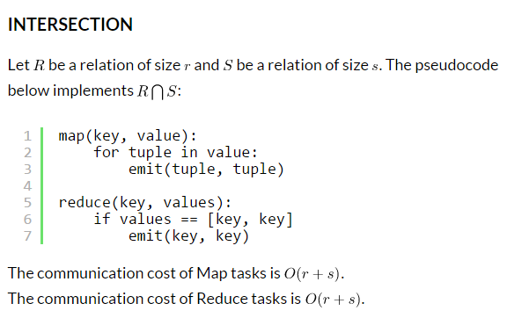

Slide 76
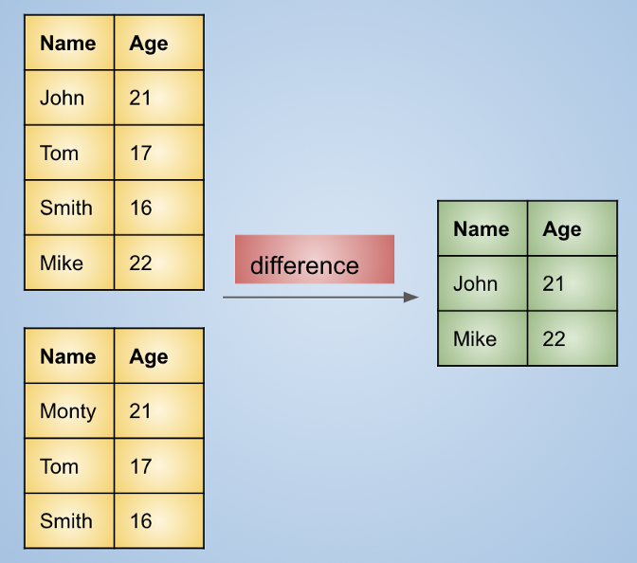
Difference
The rows that are in the first table but not in second are selected for output.
(Monty, 21) is not considered in the output as its present in the second table but not in first.

Slide 77
Difference by MapReduce
Map:
For a tuple t in R, produce key-value pair (t,R).
For a tuple t in S, produce key-value pair (t, S).
Reduce:
For each key t, if the associated value list is [R], then produce (t, t). Otherwise, produce nothing.

Slide 78
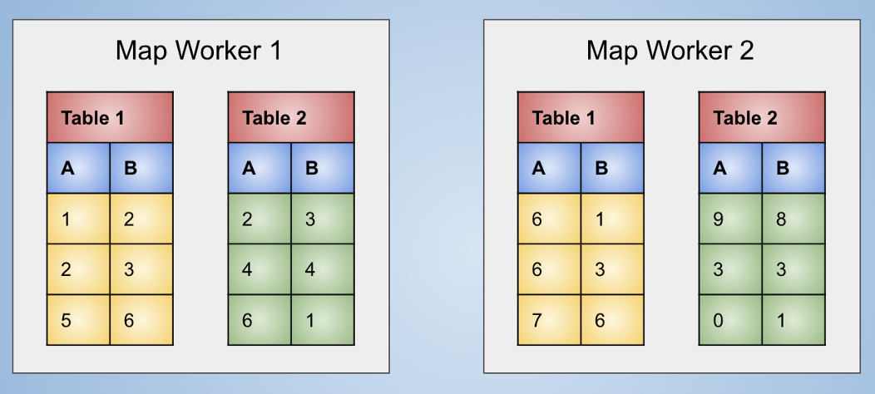
Difference by MapReduce
The data taken initially is the same as it was for union
Initial Data

Slide 79
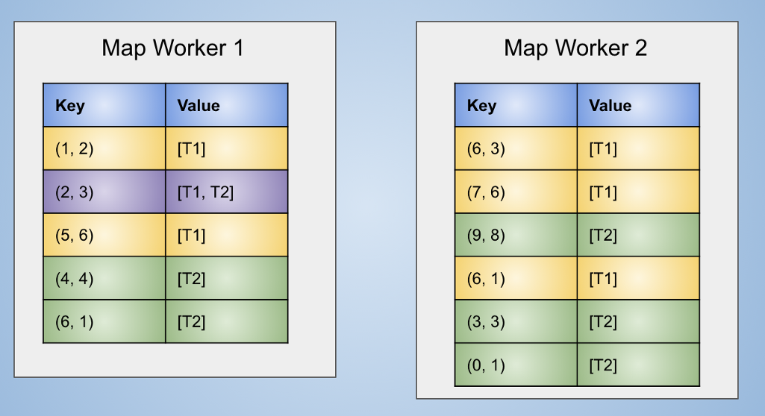
Difference by MapReduce
After applying the map function and grouping the keys the data looks like the following figure

Slide 80
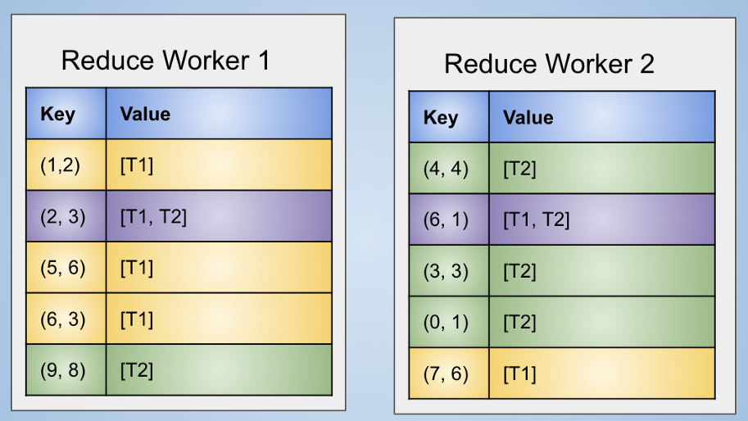
Difference by MapReduce
After aggregation of the keys at reduce workers the data looks like:

Slide 81
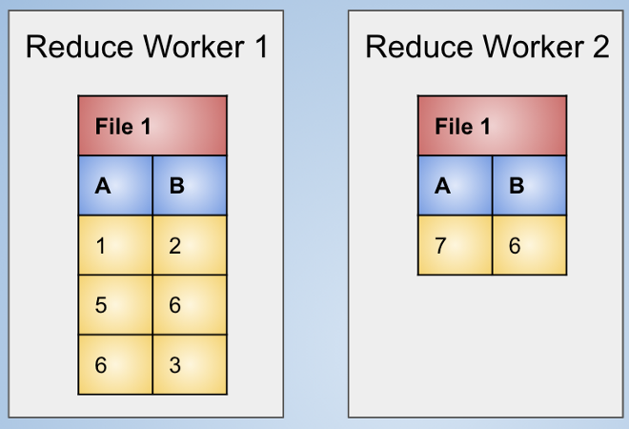
Difference by MapReduce
The final output is generated after applying the reduce function over the output.

Slide 82
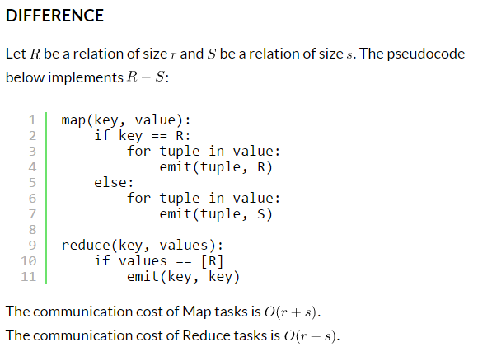

Slide 83
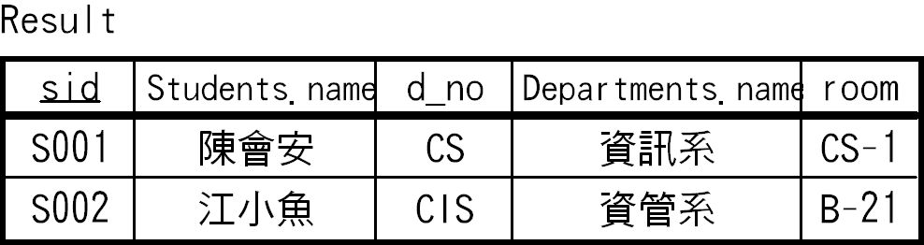
Natural Join
Given two relations, compare each pair of tuples, one from each relation. If the tuples agree on all the attributes that are common to the two schemas, then produce a tuple that has components for each of the attributes in either schema and agrees with the two tuples on each attribute.
Result = Students Departments

Slide 84
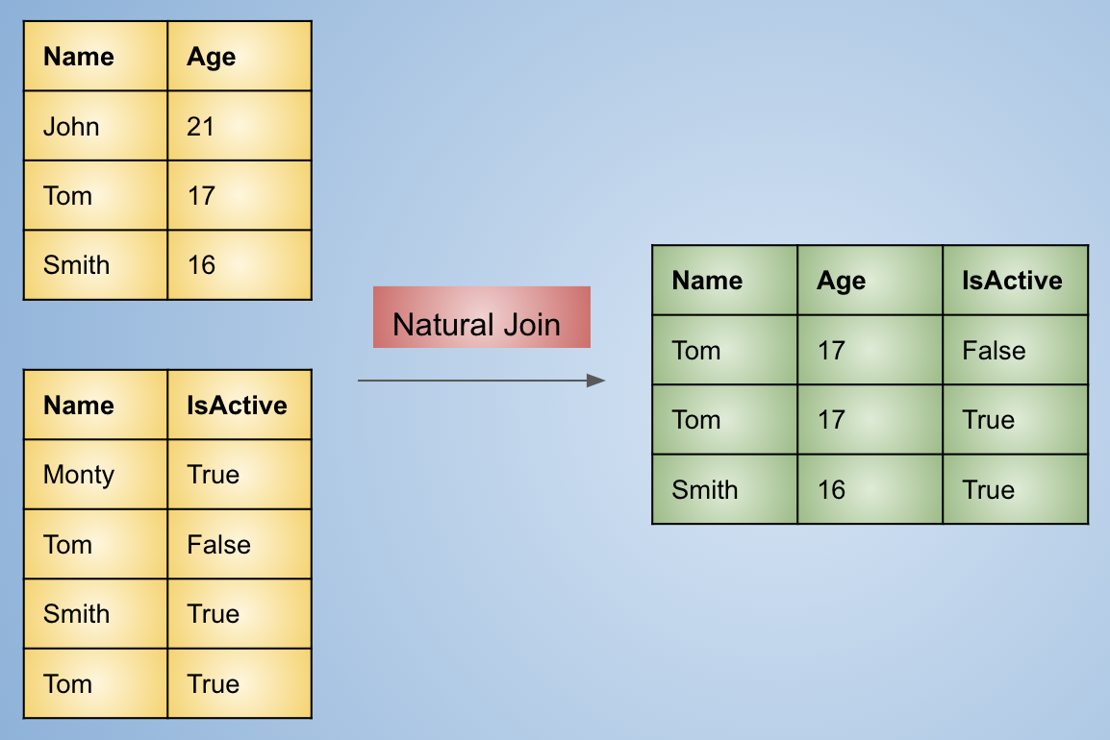
Natural Join

Slide 85
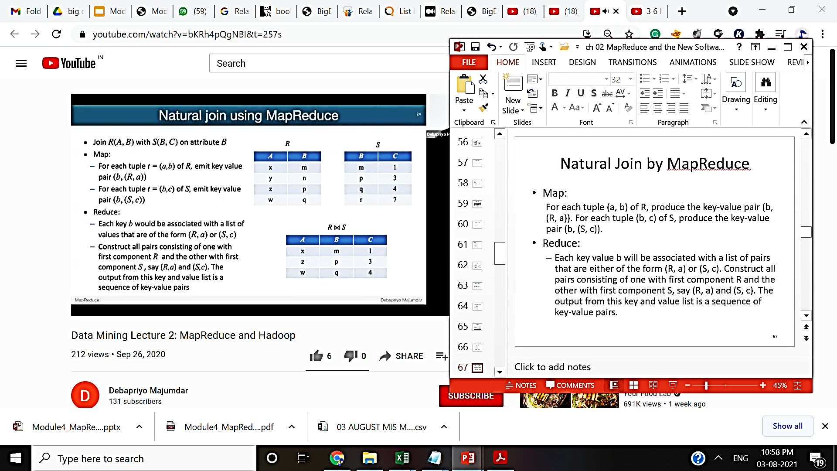
Natural Join using MapReduce

Slide 86
Natural Join by MapReduce
Map:
For each tuple (a, b) of R, produce the key-value pair (b, (R, a)). For each tuple (b, c) of S, produce the key-value pair (b, (S, c)).
Reduce:
Each key value b will be associated with a list of pairs that are either of the form (R, a) or (S, c). Construct all pairs consisting of one with first component R and the other with first component S, say (R, a) and (S, c). The output from this key and value list is a sequence of key-value pairs. The key is irrelevant. Each value is one of the triples(a,b,c) such that (R,a) and (S, c) are on the input list of values.

Slide 87
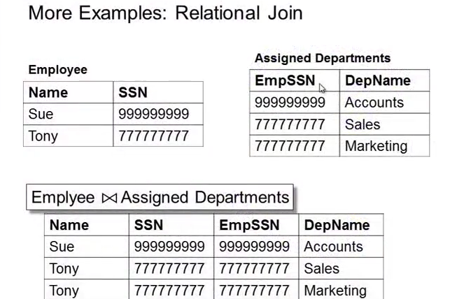
Natural Join by MapReduce

Slide 88
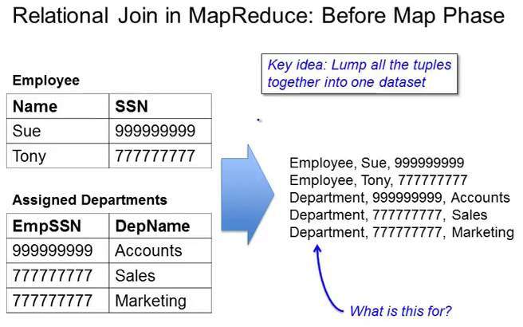

Slide 89
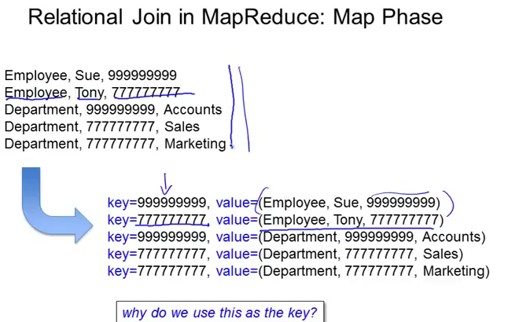

Slide 90
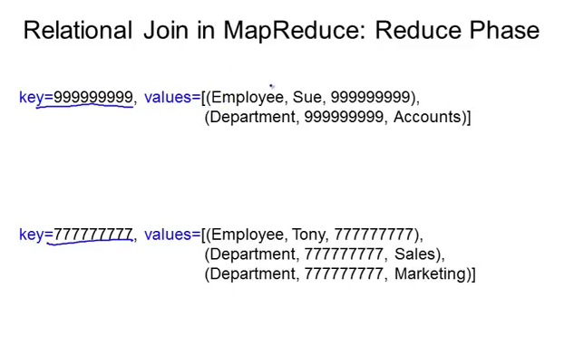

Slide 91
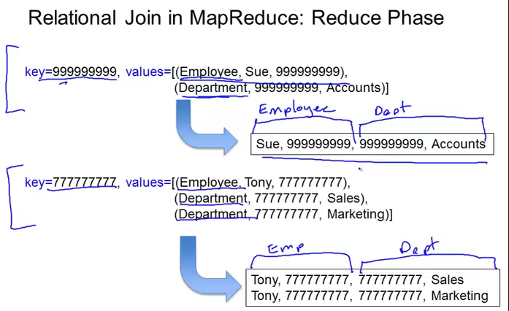

Slide 92
Grouping and Aggregation
Given a relation R, partition its tuples according to their values in one set of attributes G, called the grouping attributes. Then, for each group, aggregate the values in certain other attributes.
We denote a grouping-and-aggregation operation on a relation R by(gamma) γ_{X}(R), where X is a list of elements that are either (a) A grouping attribute, or (b) An expression θ(A), where θ is one of the five aggregation operations such as SUM,

Slide 93
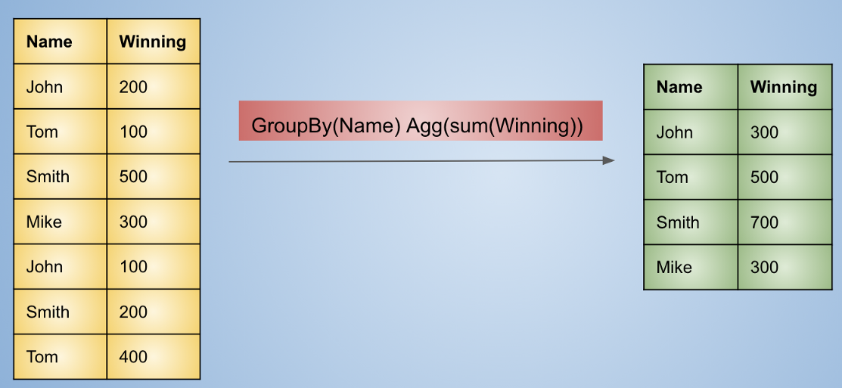
Grouping and Aggregation
Group rows based on some set of columns and apply some aggregation (sum, count, max, min, etc.) on some column of the small groups that are formed.

Slide 94
Grouping and Aggregation by MapReduce
Let R(A,B,C) be a relation to which we apply the operator γA,θ(B)(R). Map will perform the grouping, while Reduce does the aggregation.
The Map Function: For each tuple (a,b,c) produce the key-value pair (a,b).
The Reduce Function:
Each key a represents a group.
Apply the aggregation operator θ to the list [b1,b2,...,bn] of B-values associated with key a.
The output is the pair (a,x), where x is the result of applying θ to the list.

Slide 95
Grouping and Aggregation by MapReduce
Map Function:
For each row in the table, take the attributes using which grouping is to be done as the key, and value will be the ones on which aggregation is to be performed.
For example, If a relation has 4 columns A, B, C, D and we want to group by A, B and do an aggregation on C we will make (A, B) as the key and C as the value.
Reduce Function:
Apply the aggregation operation (sum, max, min, avg, …) on the list of values and output the result.

Slide 96
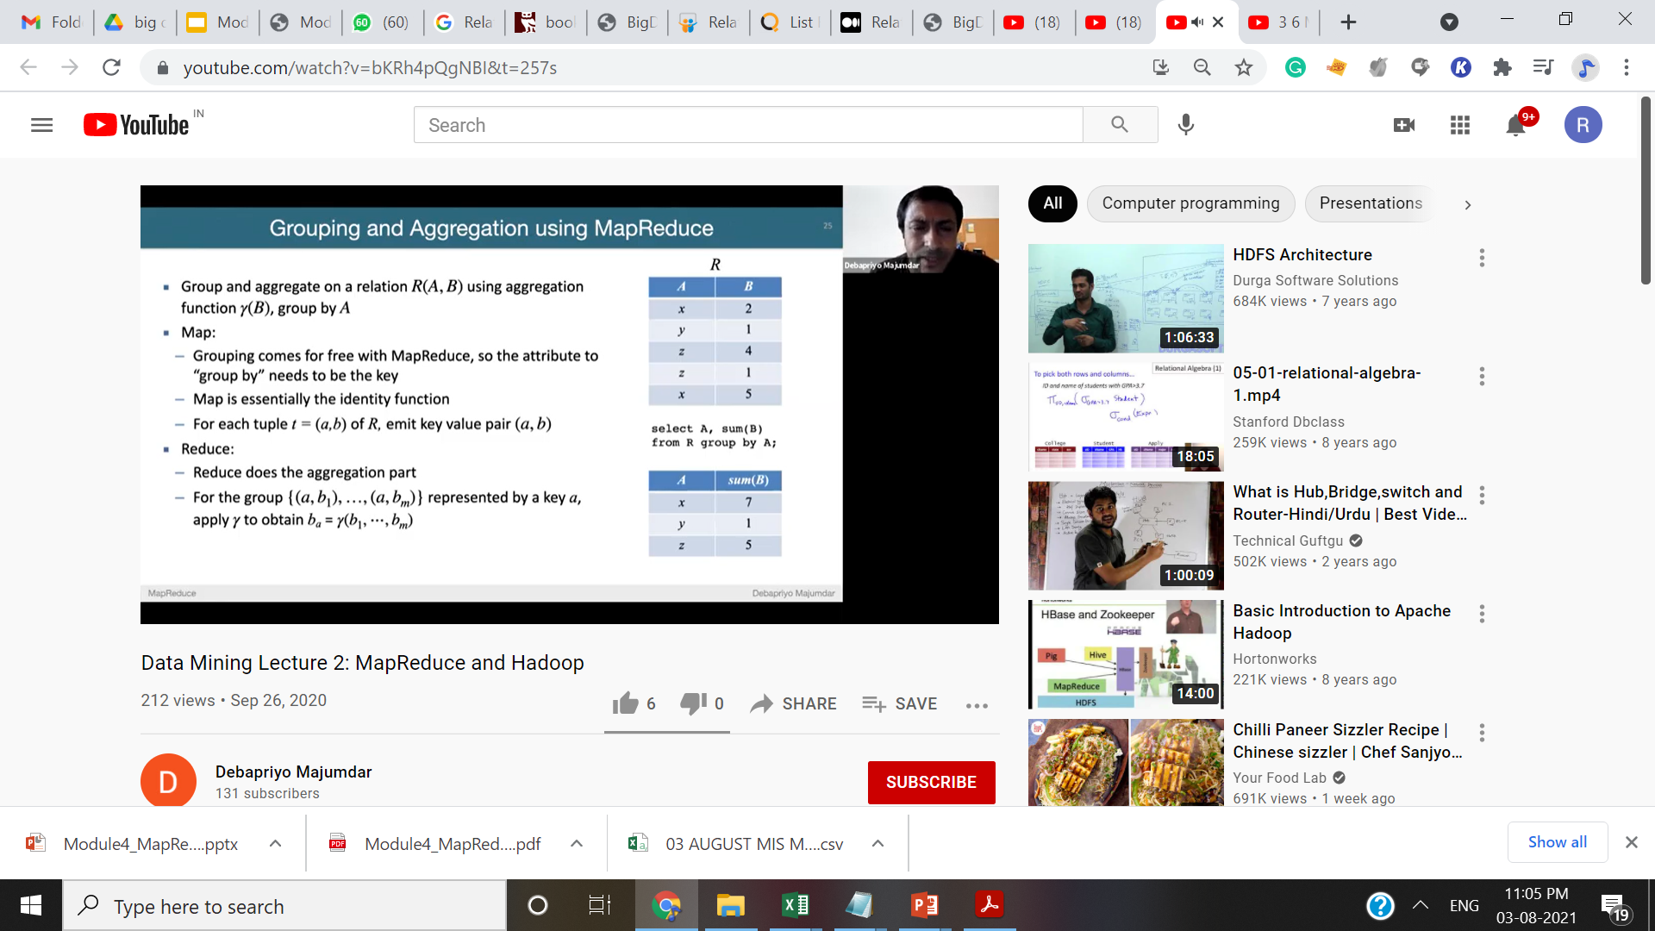
Grouping and Aggregation by MapReduce

Slide 97
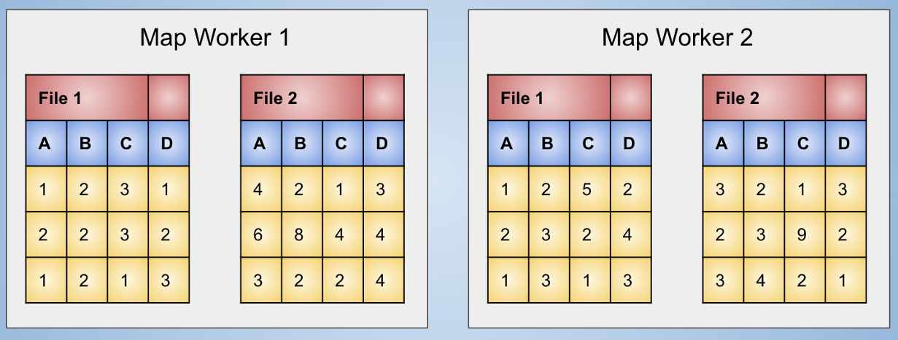
Grouping and Aggregation by MapReduce
For our example lets group by (A, B) and apply sum as the aggregation.
Initial data at the map workers

Slide 98
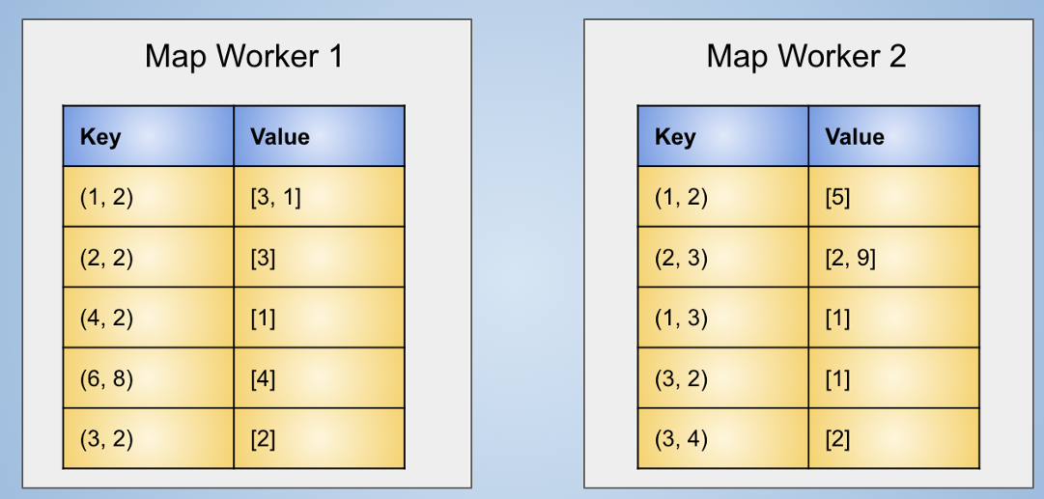
Grouping and Aggregation by MapReduce
The data after application of map function and grouping keys will creates (A, B) as key and C as value and D is discarded as if it doesn’t exist.
Initial data at the map workers

Slide 99

Grouping and Aggregation by MapReduce
Aggregated data based on keys

Slide 100

Grouping and Aggregation by MapReduce
Output of group by (A, B) sum(C)

Slide 101


Matrix-Vector Multiplication By Map-Reduce
Let A be mXn matrix
Let v be a vector of length n

Slide 102

Matrix-Vector Multiplication By Map-Reduce

Slide 103


Slide 104


Slide 105

Example

Slide 106




Slide 107


Slide 108


Slide 109


Slide 110


Slide 111


Slide 112


Slide 113
Matrix-Vector Multiplication By Map-Reduce
1 2 3 4 5 6 7 8 9 | map(key, value): for (i, j, a_ij) in value: emit(i, a_ij * v[j]) reduce(key, values): result = 0 for value in values: result += value emit(key, result)

Slide 114
Example

Slide 115
Map Phase : Generate key,Value Pair
map(key, value):
for (i, j, a_ij) in value: emit(i, a_ij * v[j])
i | j | A[i][j] | i | a[i][j]*v[j]

Slide 116
Map Phase : Generate key,Value Pair
map(key, value):
for (i, j, a_ij) in value: emit(i, a_ij * v[j])
i | j | A[i][j] | i | A[i][j]*v[j]
1 | 1 | 1 | 1 | 1
1 | 2 | 3 | 1 | 15
2 | 1 | 4 | 2 | 4
2 | 2 | 0 | 2 | 0
3 | 1 | 2 | 3 | 2
3 | 2 | 1 | 3 | 5

Slide 117
Reduce Phase
i | A[i][j]*v[j]
1 | 1
1 | 15
2 | 4
2 | 0
3 | 2
3 | 5
reduce(key, values):
result = 0
for value in values:
result += value
emit(key, result)

Slide 118
Reduce Phase
i | result
1 | 16
2 | 4
3 | 7
https://www.youtube.com/watch?v=c3loR2znLDI

Slide 119
University Question
Show Map Reduce implementation for the following two tasks using pseudocode.
i) Join of two relations with an example
ii)Multiplication of two matrices with one Map reduce step. [FH-2016 COMP]
Explain Matrix –Vector multiplication algorithm by Map Reduce [FH- 2016 IT]
Give 2-Step Map Reduce algorithm to multiply two large matrices. [SH2016- Comp]
Give Map Reduce algorithm for Natural Join of two relations [SH-2016 Comp]
Show Map Reduce implementation for the following two tasks using pseudocode.
- Multiplication of two matrices
- Computing Group By and aggregation of a relational table

Slide 120





